Slide 1





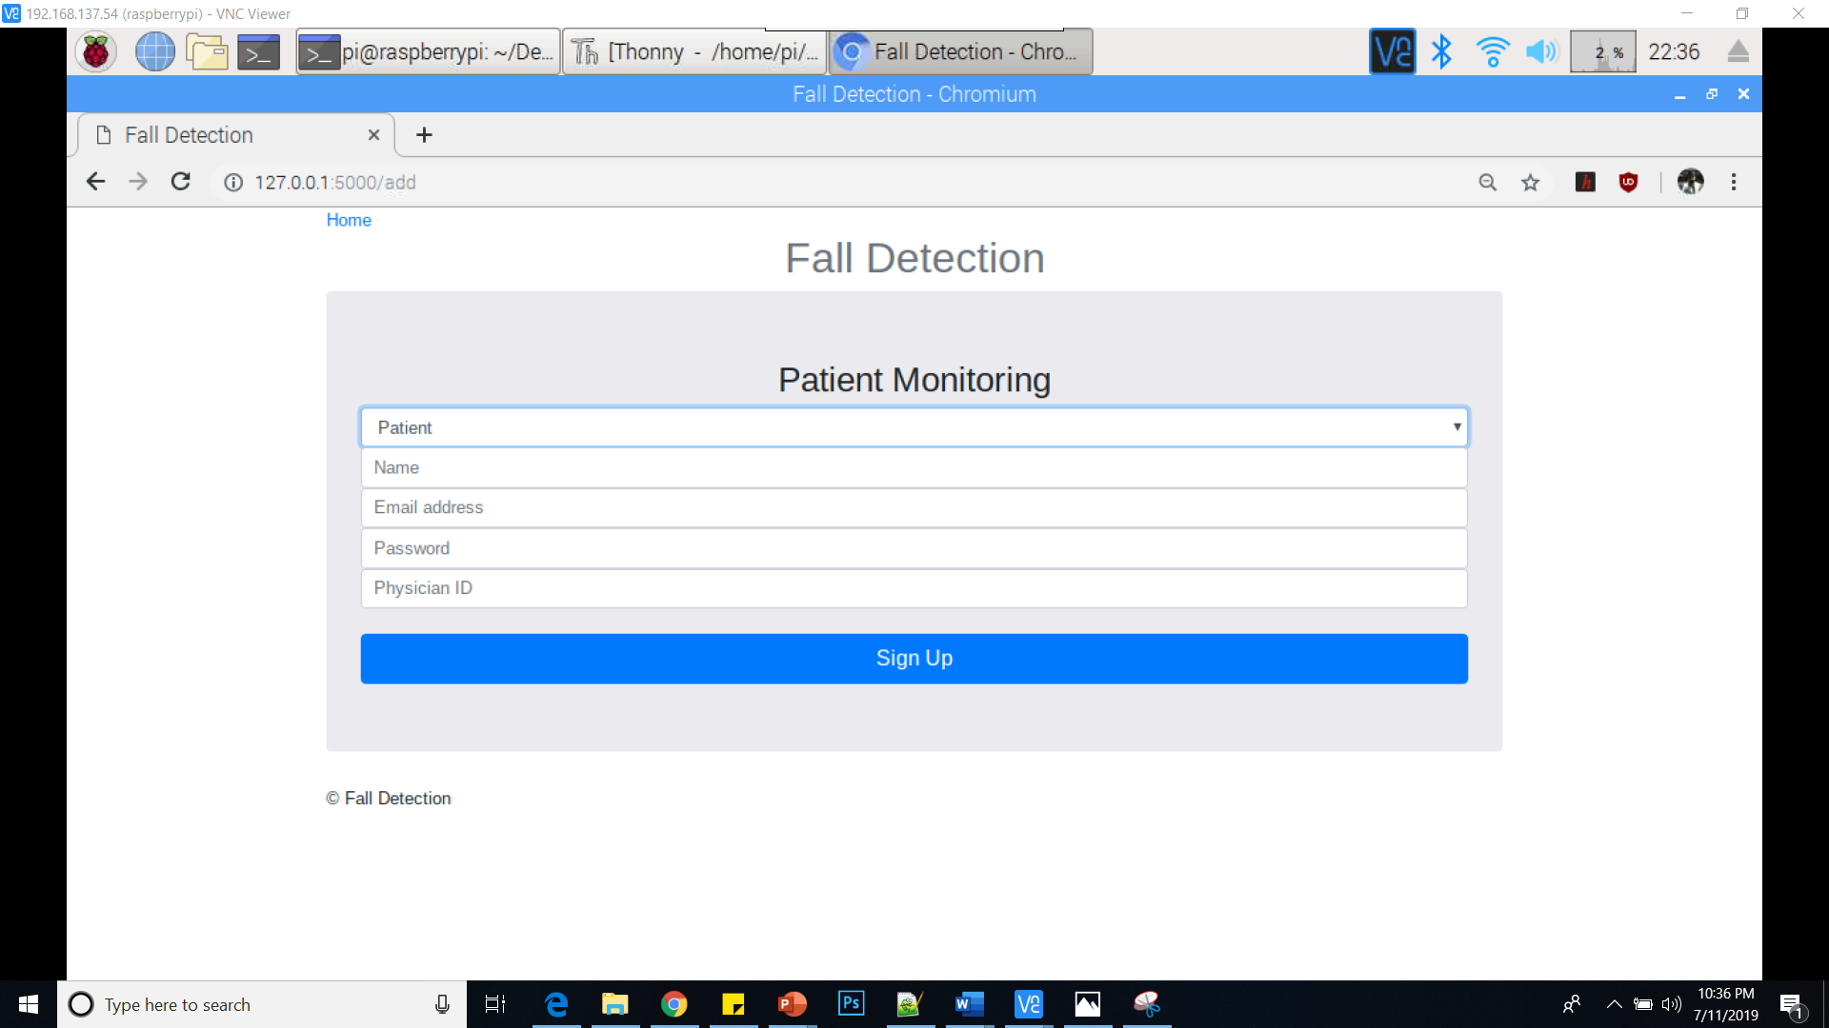
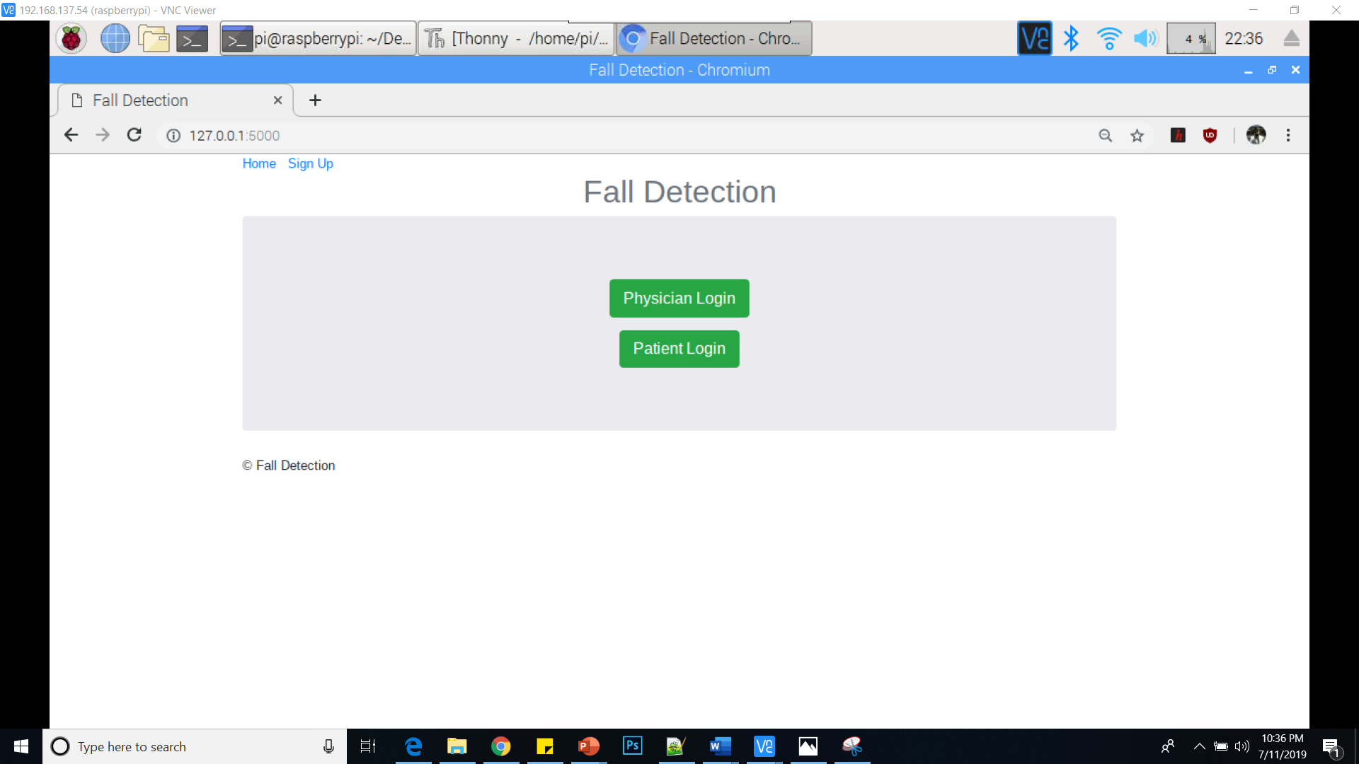
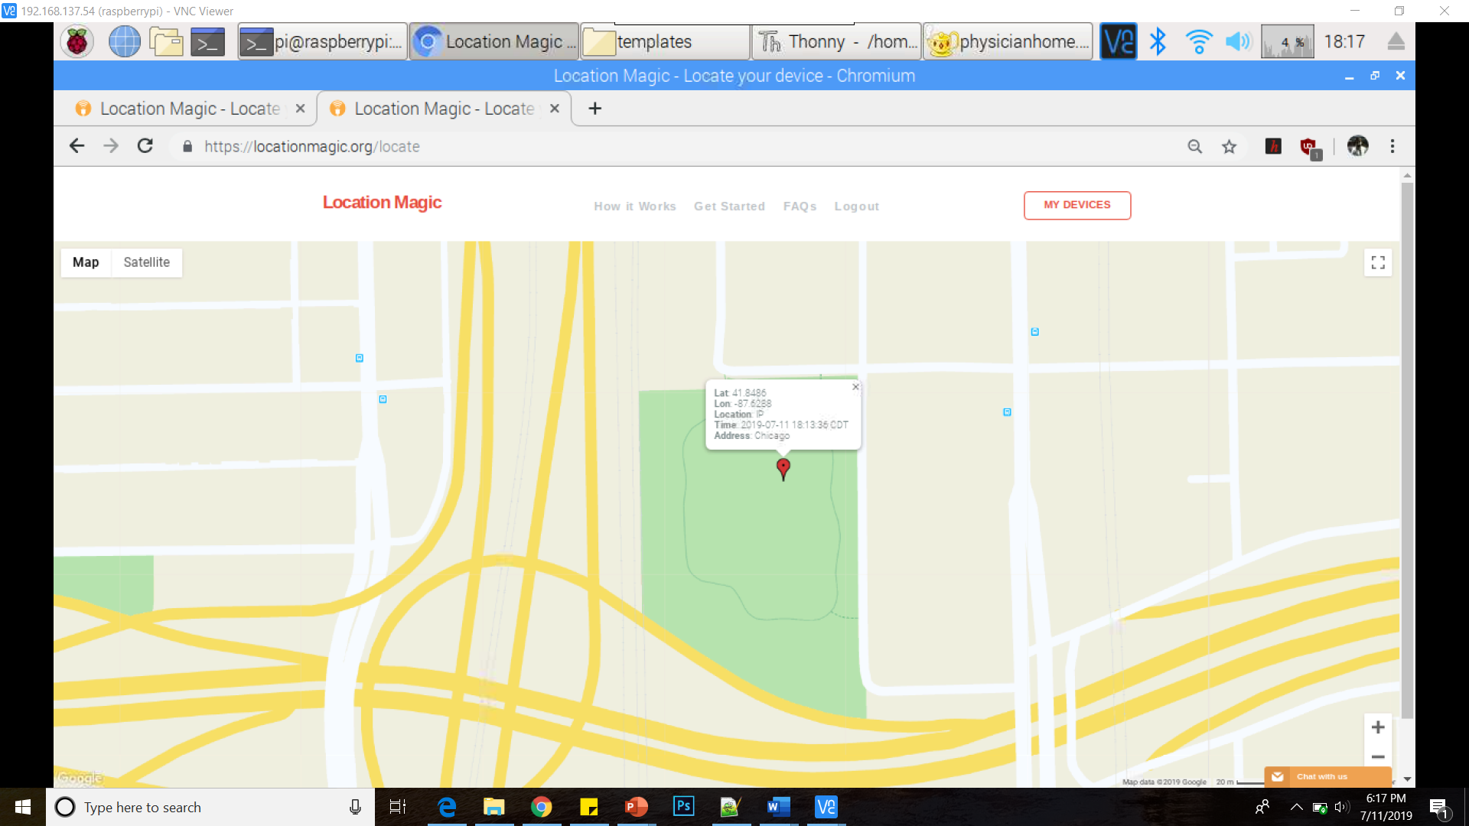
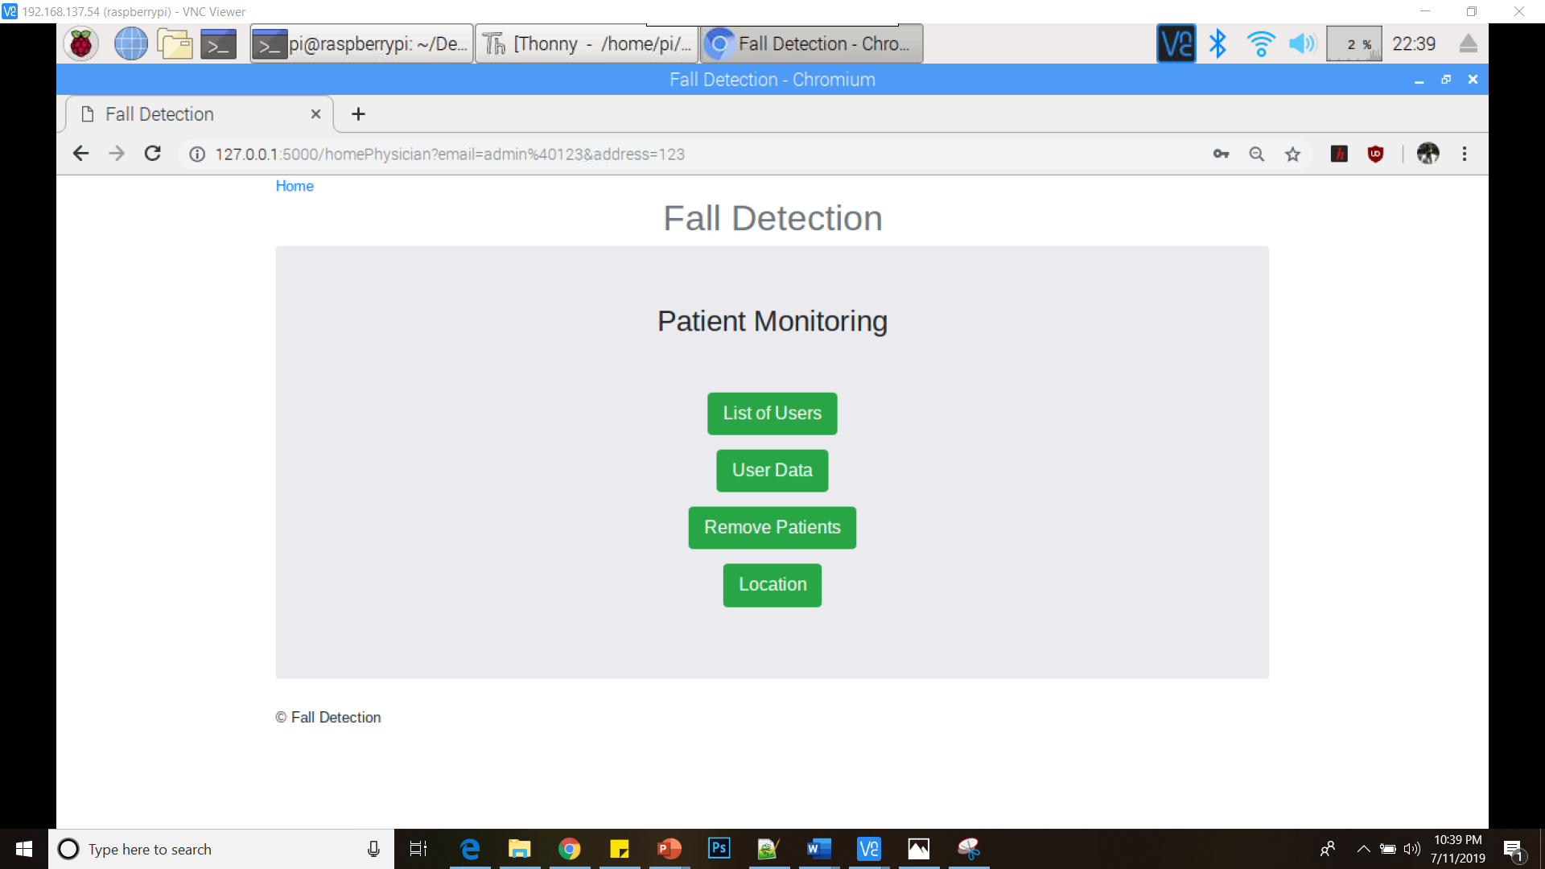
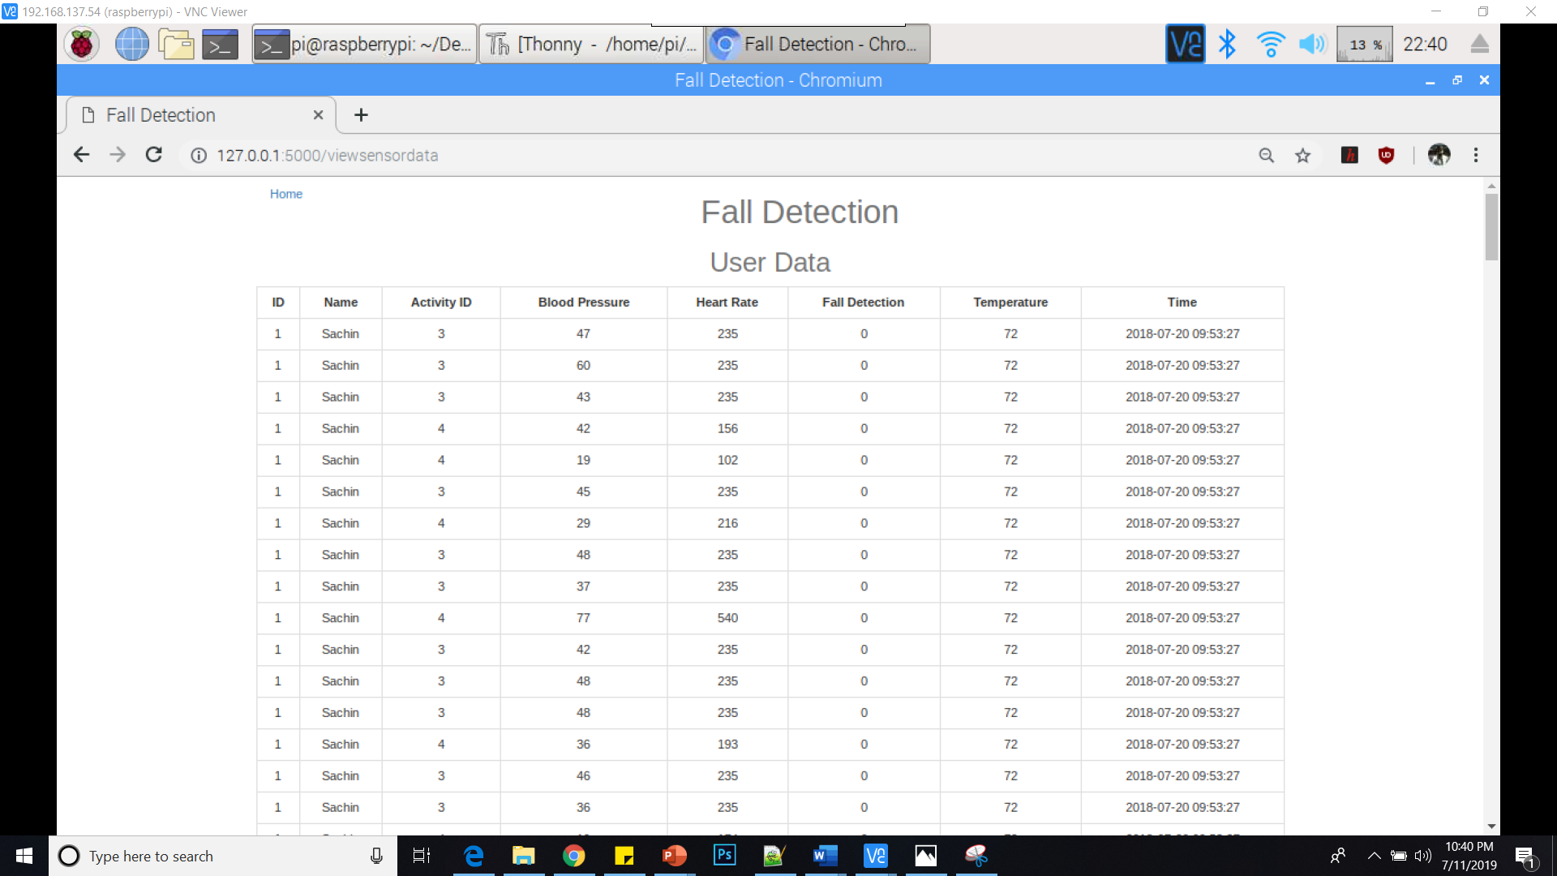
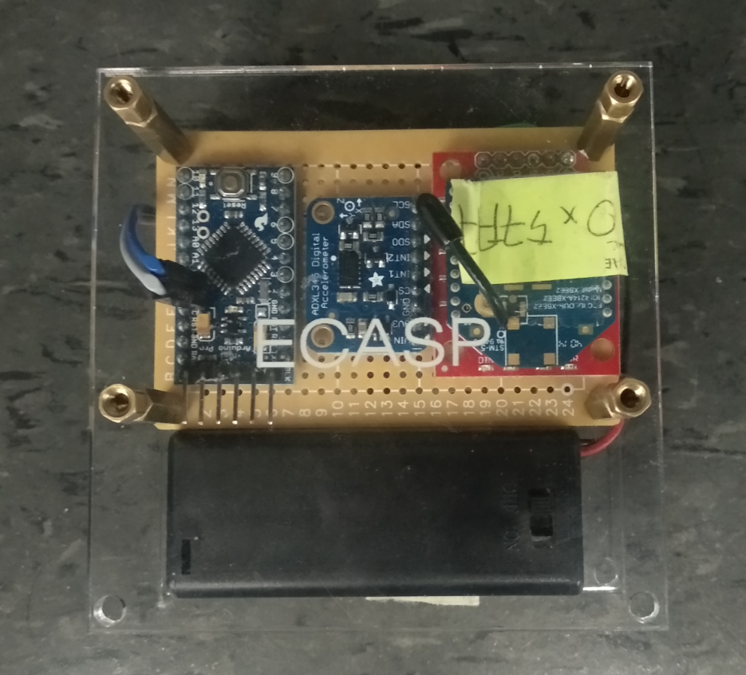
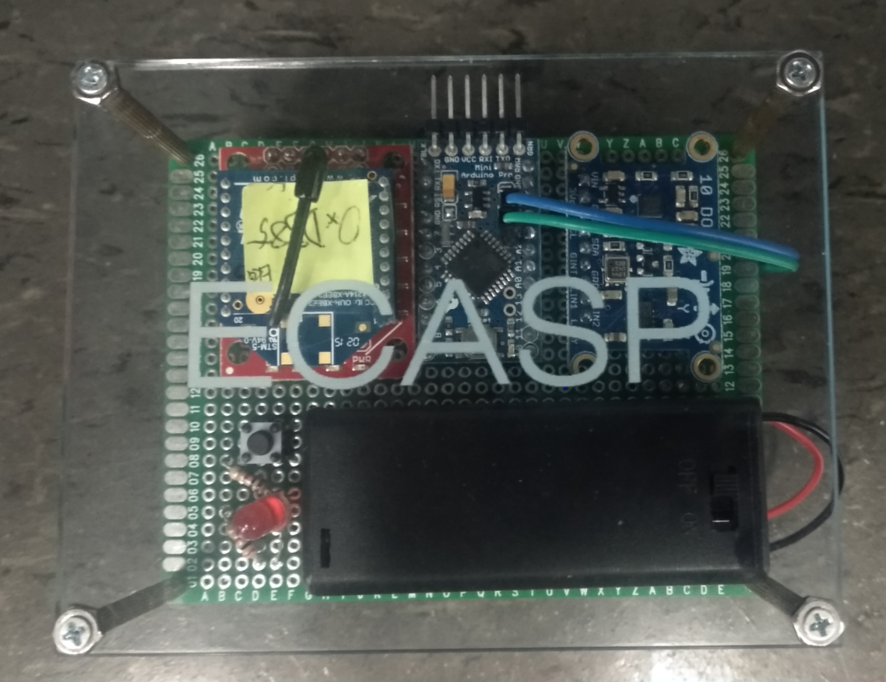
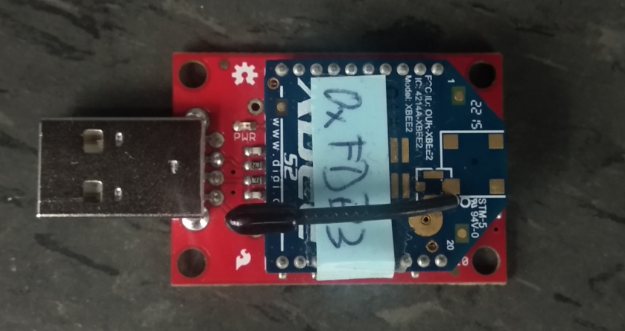
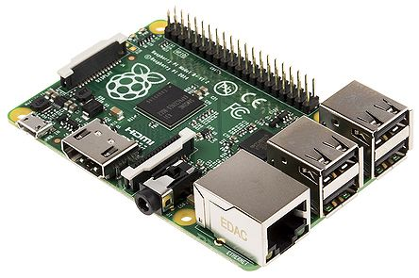
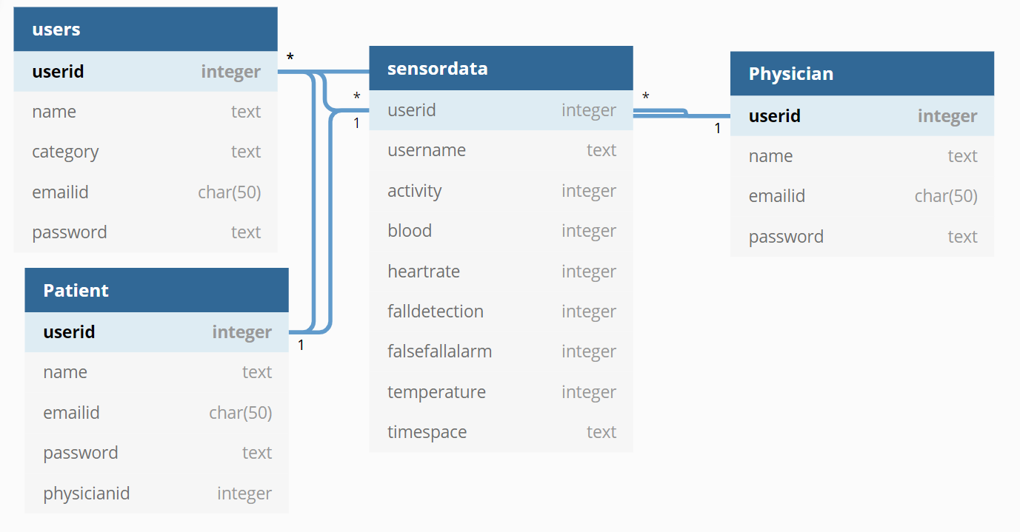
Web Application for IoT Based Fall Detection System
Sachin Raja
Advisors: Dr. Jafar Saniie
Department of Electrical and Computer Engineering,
Embedded Computing and Signal Processing Research Laboratory
Abstract
Web - Application
Location Determination
In general most of the people want to have an independent life and live on themselves, especially patients. It is essential to monitor their vital signs, health and safety. Internet of Things (IoT) has provides better access to monitor the data remotely. If the person has had a fall at a remote location, it’s a tedious task to find the patient. So the location of a fall of a patient is also important along with the detection of a fall. This can be done by
The body sensors that are connected to the internet and the data from these sensors along with the location is saved on the database.
It is then analyzed and interpreted through a website.
In this project we monitor the vital data of a person through a website created and provides a remote system for alerting and detecting dangerous falls of the patient to the physician. With the help of data analysis we analyze the vital information of the patient along with the location of the patient and trigger an email to the physician so that proper actions can be taken at the right time.
The web application is built using the python-flask microweb
framework. Flask is suitable for this application as it is very
light and doesn’t require much space.
The front end of the website is built using HTML, JavaScript,
CSS3 and bootstrap as they provide a pleasing user experience.
For determining the location of the patient a LocationAPI from unwired labs is used.
This GeoLocation API can locate any IoT and other connected devices without a GPS.
Using the cellular and Wi-Fi network nearby the device is located based on the various access points available and the available access points are sent to unwired labs server.
This data is being analyzed using large datasets of cell towers and Wi-Fi networks that are assisted by complex algorithms to send back the location of the device.
The location of the raspberry pi is returned as shown below using the token generated for the device
The API returns a location as above providing the latitude and longitude values of the location.
The below represents the website with the user registration and the user login
Objectives
Detect falls, false fall alarms and the location of the fall
Creating a website to store, collect, and display the collected data
The user signup page where the user can sign up as a physician or a patient. The patient will be tagged to a physician always.
This is the home page of the website and based on the selected options the user can login
System Design & Hardware
Conclusion
The system differentiates falls and false alarms and It uploads the sensor data to the SQLite3 database successfully. The elimination of GPS sensor reduces the cost.
The website is designed in such a way that there are two different views for both physician and patient.
This application has allowed the system to provide greater insight into the patient’s well-being. The location of the fall is also displayed on the website providing a many possibilities for the physician to help the patient.
physician home page where he can view the location of the patients fall, patient's vital data, and also can remove the user from the system.
The patient's vital data is represented in the form of a table as shown above
Database Organization
References
The Thigh Module
Arduino Pro Mini
ADXL345 - 3-axis accelerometer
XBee Module - Transmits sensor data to the Raspberry Pi
The Chest Module
Arduino Pro Mini
L3GD20/LSM303 - 3-axis gyroscope and 3-axis accelerometer
XBee Module - Transmits sensor data to the lRaspberry Pi
1] W.-J. Yi, B. David Arnold, Andrew Mustea and J. Saniie, "IoT Remote Health Monitoring System," ECASP Lab, Chicago, 2018. 2] Kabalan Chaccour, Rony Darazi ; Amir Hajjam El Hassani ; Emmanuel Andrès
From Fall Detection to Fall Prevention: A Generic Classification of Fall-Related Systems, 2016.
XBee Module (Up) - Receiver unit for central coordinator
Raspberry Pi (Down)- Microcontroller for the Chest unit
Future Work
Fall Detection
This system can be implemented on a cloud-based infrastructure and which can improve the performance of the website. We can use a TCP client app to fetch the location data from the cell phone itself.
Raspberry Pi will run the C++ program that uses an algorithm to determines the position of the sensors and predicts if a fall has occurred.
The Raspberry Pi will differentiate between the thigh and chest module and will proceed to check the received data and determine whether a change in position has been detected. This system will make the decision based on the flowchart on the right.
We used SQLite3 as the database and used it as a relational database so each table in the database is related to the other. The tables are linked together using the user id of each user (the patient or the physician)
Acknowledgements
The members of the ECASP lab and advisors for their valuable insights and support

